Slide 1
Lecture 8 Distinguishing between the Needs of the Self and the Body

Slide 2
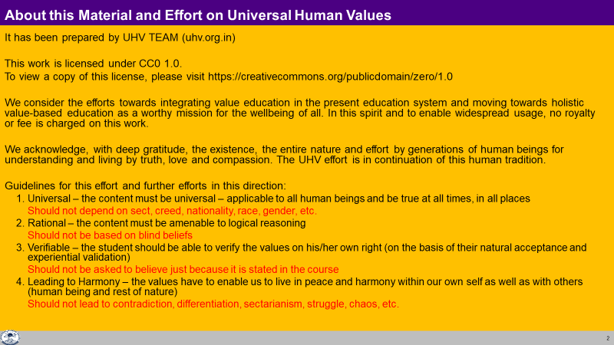

Slide 3
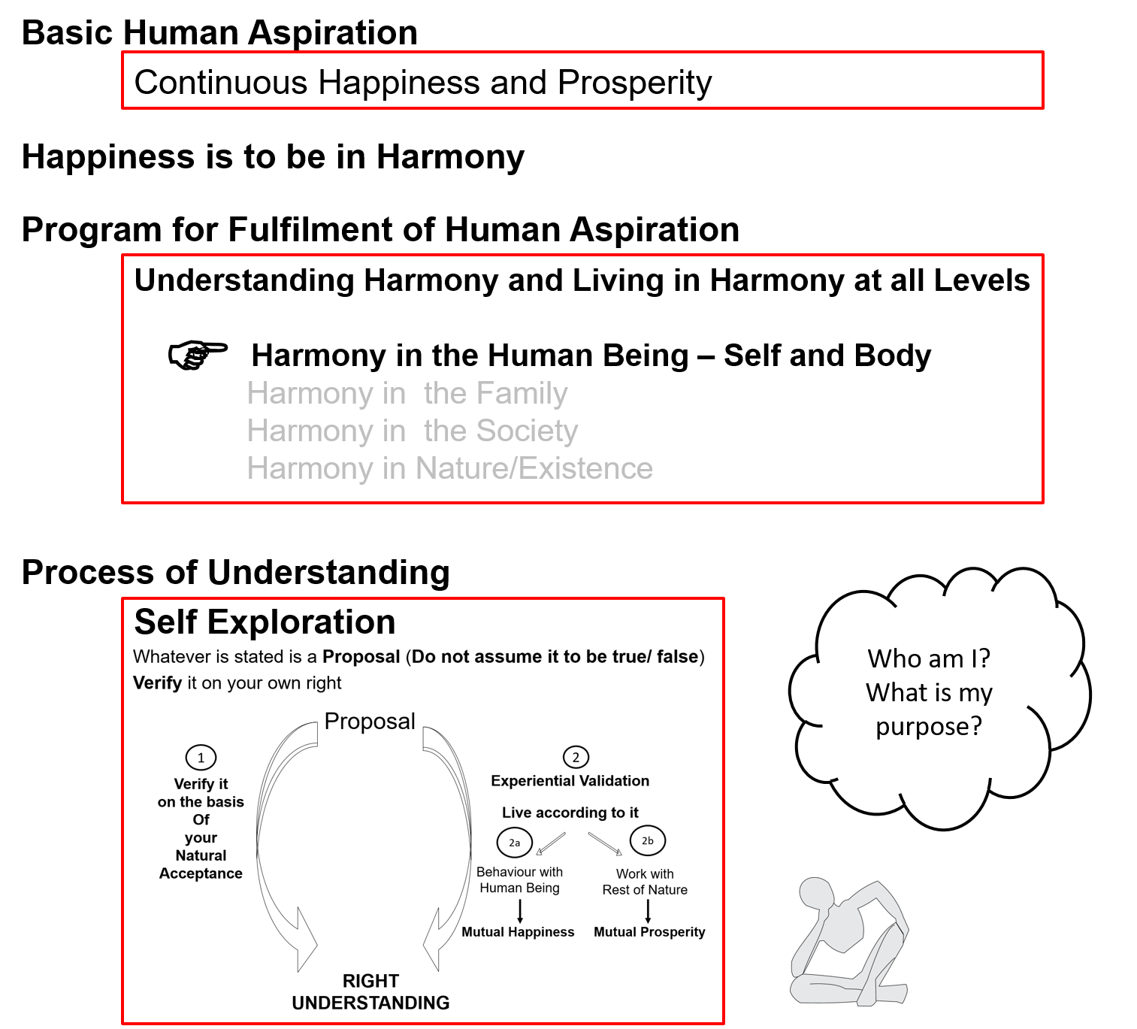

Slide 4
Human Being | Self | Body
Need | Happiness (e.g. Respect) | Physical Facility (e.g. Food)
In Time | Continuous | Temporary
In Quantity | Qualitative (is Feeling) | Quantitative (Required in Limited Quantity)
Fulfilled By | Right Understanding & Right Feeling | Physio-chemical Things
Activity | Desire, Thought, Expectation… | Eating, Walking…
In Time | Continuous | Temporary
Response | Knowing, Assuming, Recognising, Fulfilling | Recognising, Fulfilling
 | Consciousness | Material
Co-existence

Slide 5
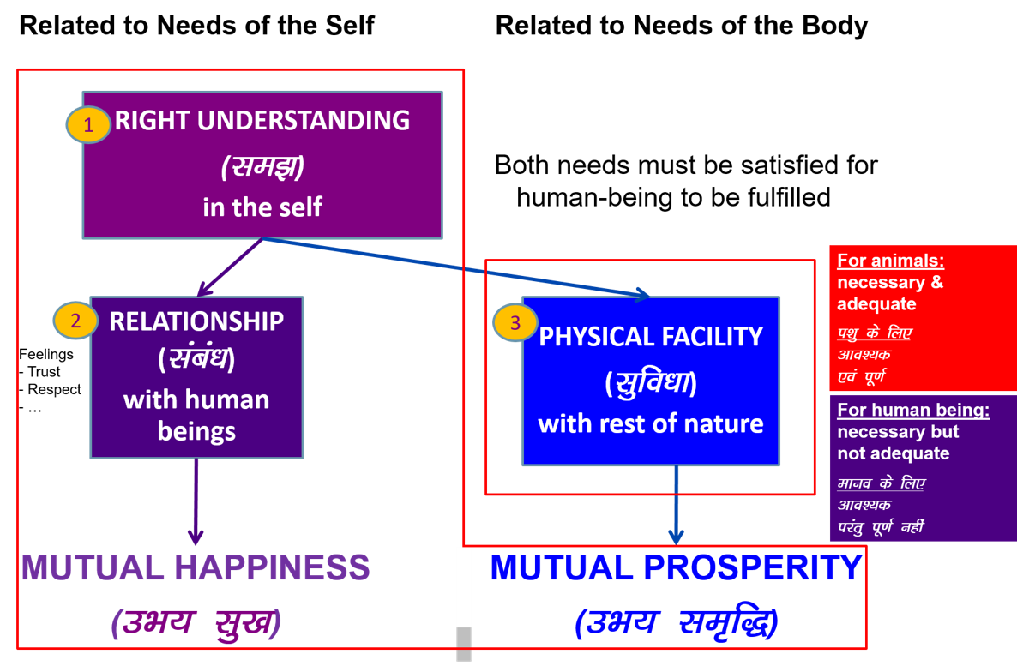

Slide 6
Consciousness
Need of the Self = Continuous happiness = Need of consciousness
Fulfilled by = Right Understanding and Right Feeling in the Self = Activities of consciousness
(can not be fulfilled by material)
(The need of consciousness is fulfilled by activities of consciousness)
Notes:
Fulfilled by
Flower to Father – flower is only a symbol. Feeling is primary. Feelings ka bandh mein band kar rakha hai – feelings ka aadan-pradan nahin hota. Feelings ka exchange bhi sukhi hone ka tareeka hai, yeh dhyan mein nahin aaya rahta
One cant fulfill the other
Exclusive dress – attention neq respect. Dress se attention bhar mil paata hai

Slide 7
Need of the Body = Physical facility* = Material in nature
Fulfilled by = Physio-chemical things = Material in nature
(The need of material is fulfilled by material)
*physical facility is required for nurturing, protection and right utilization of the Body
Notes:
Fulfilled by
Flower to Father – flower is only a symbol. Feeling is primary. Feelings ka bandh mein band kar rakha hai – feelings ka aadan-pradan nahin hota. Feelings ka exchange bhi sukhi hone ka tareeka hai, yeh dhyan mein nahin aaya rahta
One cant fulfill the other
Exclusive dress – attention neq respect. Dress se attention bhar mil paata hai

Slide 8

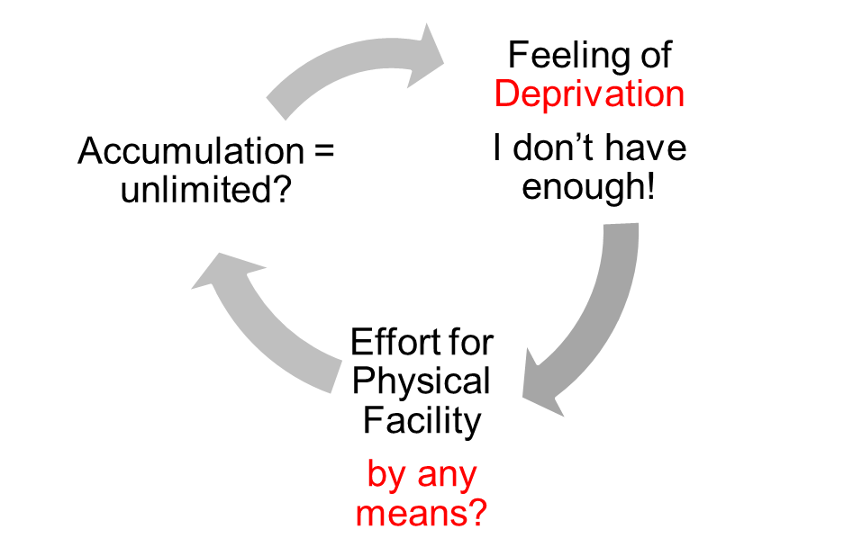
Gross Misunderstanding
Human Being | Self (I) | = | Body
Need | Respect | = | Physical Facility (Eg. Food, Clothes)
 | Continuous | = | Unlimited
Accumulation of Physical Facility – Unlimited!
Loop
Check if you
are caught up
In this loop
Deprivation

Slide 9
Sum Up
Human being is a co-existence of Self (consciousness) and Body (material)
The needs of the Self and the Body are of two different types, and they have to be fulfilled separately
The need of the Self is continuous happiness
The need of the Body is physical facility
The need of consciousness is fulfilled by activity of consciousness (it can not be fulfilled by material)
The needs of material is fulfilled by material
A gross misunderstanding is to assume the human being to be the Body (material), and to assume that all human needs can be fulfilled by material – this leads to deprivation, exploitation, etc

Slide 10
Self Reflection

Slide 11
Key Points
Distinguishing between the Needs of the Self and the Body

Slide 12
Human Being Ekkuo | Self eSa | Body “kjhj
Need vko';drk | Happiness (e.g. Respect) lq[k ¼tSls lEeku½ | Physical Facility (e.g. Food) lqfo/kk ¼tSls Hkkstu½
In Time dky esa | Continuous fujUrj | Temporary lkef;d
In Quantity ek=k esa | Qualitative (is Feeling) xq.kkRed ¼Hkko gS½ | Quantitative (Required in Limited Quantity) Ekk=kRed ¼lhfer ek=k esa½
Fulfilled By iwfrZ ds fy, | Right Understanding & Right Feeling lgh le>] lgh Hkko | Physio-chemical Things HkkSfrd&jklk;fud oLrq
Activity fØ;k | Desire, Thought, Expectation… bPNk] fopkj] vk”kk--- | Eating, Walking… [kkuk] pyuk---
In Time dky esa | Continuous fujUrj | Temporary lkef;d
Response | Knowing, Assuming, Recognising, Fulfilling tkuuk] ekuuk] igpkuuk] fuokZg djuk | Recognising, Fulfilling igpkuuk] fuokZg djuk
 | Consciousness pSrU; | Material tM+
Co-existence
lgvfLrRo

Slide 13
the
Human Being Ekkuo | Self eSa | Body “kjhj
Need vko';drk | Happiness (e.g. Respect) lq[k ¼tSls lEeku½ | Physical Facility (e.g. Food) lqfo/kk ¼tSls Hkkstu½
In Time dky esa | Continuous fujUrj | Temporary lkef;d
In Quantity ek=k esa | Qualitative (is Feeling) xq.kkRed ¼Hkko gS½ | Quantitative (Required in Limited Quantity) Ekk=kRed ¼lhfer ek=k esa½
Fulfilled By iwfrZ ds fy, | Right Understanding & Right Feeling lgh le>] lgh Hkko | Physio-chemical Things HkkSfrd&jklk;fud oLrq
Co-existence
lgvfLrRo
Consciousness
Need of the Self = Continuous happiness = Need of consciousness
Fulfilled by = Right Understanding and Right Feeling in the Self = Activities of consciousness
(can not be fulfilled by material)
(The need of consciousness is fulfilled by activities of consciousness)
Notes:
Fulfilled by
Flower to Father – flower is only a symbol. Feeling is primary. Feelings ka bandh mein band kar rakha hai – feelings ka aadan-pradan nahin hota. Feelings ka exchange bhi sukhi hone ka tareeka hai, yeh dhyan mein nahin aaya rahta
One cant fulfill the other
Exclusive dress – attention neq respect. Dress se attention bhar mil paata hai

Slide 14
the
Human Being Ekkuo | Self eSa | Body “kjhj
Need vko';drk | Happiness (e.g. Respect) lq[k ¼tSls lEeku½ | Physical Facility (e.g. Food) lqfo/kk ¼tSls Hkkstu½
In Time dky esa | Continuous fujUrj | Temporary lkef;d
In Quantity ek=k esa | Qualitative (is Feeling) xq.kkRed ¼Hkko gS½ | Quantitative (Required in Limited Quantity) Ekk=kRed ¼lhfer ek=k esa½
Fulfilled By iwfrZ ds fy, | Right Understanding & Right Feeling lgh le>] lgh Hkko | Physio-chemical Things HkkSfrd&jklk;fud oLrq
Co-existence
lgvfLrRo
Material
Need of the Body = Physical facility* = Material in nature
Fulfilled by = Physio-chemical things = Material in nature
(material is definitely required, but guidance of consciousness is also required)
(The need of material is fulfilled by material)
*physical facility is required for nurturing, protection and right utilization of the body
Notes:
Fulfilled by
Flower to Father – flower is only a symbol. Feeling is primary. Feelings ka bandh mein band kar rakha hai – feelings ka aadan-pradan nahin hota. Feelings ka exchange bhi sukhi hone ka tareeka hai, yeh dhyan mein nahin aaya rahta
One cant fulfill the other
Exclusive dress – attention neq respect. Dress se attention bhar mil paata hai

Slide 15
Gross Misunderstanding
Human Being Ekkuo | Self (I) eSa | = | Body “kjhj
Need vko’;drk | Respect lEeku | = | Physical Facility (Eg. Food, Clothes) lqfo/kk (tSls&Hkkstu] diM+k)
 | Continuous fujUrj | = | Unlimited vlhfer
Accumulation of Physical Facility – Unlimited!
Lqfo/kk laxzg & vlhfer!
Loop
Check if you
are caught up
this loop
Deprivation
nfjnzrk

Slide 16
FAQs for Lecture 8
Distinguishing between the Needs of the Self and the Body

Slide 17
Question(s) 1: Needs of Self and Body Response
Are we only talking about the basic needs of a human being here? What about the higher needs?
We need food and also the taste. So you are saying that only Self needs taste. Similarly, clothes are needed for the body but clothes which are trending or in fashion are needed for the Self. Isn’t it? Why do we need to see this separately?
There can be many desires which are inter-connected for Body and Self. E.g. Money. In that case how to distinguish whether the desire is for Body or Self?
All the needs- of the self and of the body
Because, they are of two different types, and they have to be fulfilled differently, e.g. need for clothes for protection of the body is required in limited quantity while need for clothes for getting respect becomes undefined.
Need of the self ultimately relates to the need of continuous happiness, whereas, need for body is related nurturing, protection and right utilisation of the body. Money is a man-made artefact, used for exchange of physical facility, relating to the need of the body.

Slide 18
Question(s) 1: Needs of Self and Body Response
We discussed Maslow’s hierarchy of needs. By distinguishing needs of the Self and Body, how will it look?
Need of the self is of higher priority, if we take care of the need of the self through right understanding and feeling, then it will the fulfillment of the need of the body very easy.

Slide 19
What is feeling? Does it happen only in self or it also has an effect on the body as well?
What is right feeling?
Can a feeling which is right for me, may be wrong for someone else?
Are you talking about spirituality? Or
Are you trying to make us spiritual?
Feeling is basically my acceptance of relationship, affection for example. This is certainly in the self. It might reflect at the level of the body, if self sends some instruction to the body on the basis of it, consciously or un consciously.
Feeling that is naturally acceptable to us is the right feeling.
No.
We are trying to work for a system of education that makes us human. So, we are talking about humanness- what is being human.

Slide 20
If this is spirituality, then our religious texts have answer to all such questions. Why not refer to them directly?
Truth is eternal but, its expression is ever fresh. If we can understand the truth, we can see that it is there in the wisdom of the tradition as well. Then we can also see that the great man of this world have been essentially trying to express the truth in a manner which was suitable for that time, society and people. Everyone of us has to understand the truth through our self-investigation, through direct observation and then we can also see that these are expressed in the texts also. So, texts are veyy useful source for right kind of proposals about the truth, the reality.

Slide 21
The exercise on list of desires was interesting. Most of my needs turned out to be needs of the Self and I was trying to address them using some physical facility. So now, I can understand the need for right understanding and right feeling within. What exactly should I do for developing this?
This is what we are going to talk about all through the course- understanding of harmony at all levels of our being from individual, family, society, to nature/ existence. Once we have the understanding of harmony, we will have the feeling of harmony and that will also be detailed out.

